Slide 1
Binary Logic
Deals with binary variables that take 2 discrete values (0 and 1), and with logic operations
Three basic logic operations:
  AND, OR, NOT
Binary/logic variables are typically represented as letters: A,B,C,…,X,Y,Z

Slide 2
Binary Logic Function
F(vars) = expression
Example: F(a,b) = a’•b + b’
G(x,y,z) = x•(y+z’)
Operators ( +, •, ‘ )
Variables
Constants ( 0, 1 )
Groupings (parenthesis)
set of binary
variables

Slide 3
Basic Logic Operators
AND
OR
NOT
F(a,b) = a•b, F is 1 if and only if a=b=1
G(a,b) = a+b, G is 1 if either a=1 or b=1
H(a) = a’, H is 1 if a=0
Binary
Unary

Slide 4
Basic Logic Operators (cont.)
1-bit logic AND resembles binary multiplication:
  0 • 0 = 0, 0 • 1 = 0,
  1 • 0 = 0, 1 • 1 = 1
1-bit logic OR resembles binary addition, except for one operation:
  0 + 0 = 0, 0 + 1 = 1,
  1 + 0 = 1, 1 + 1 = 1 (≠ 10₂)

Slide 5
Truth Tables for logic operators
Truth table: tabular form that uniquely represents the relationship between the input variables of a function and its output
2-Input AND
2-Input OR
A | B | F=A•B
0 | 0 | 0
0 | 1 | 0
1 | 0 | 0
1 | 1 | 1
A | B | F=A+B
0 | 0 | 0
0 | 1 | 1
1 | 0 | 1
1 | 1 | 1
NOT
A | F=A’
0 | 1
1 | 0

Slide 6
Truth Tables (cont.)
Q: Let a function F() depend on n variables. How many rows are there in the truth table of F() ?
A: 2^{n} rows, since there are 2^{n} possible binary patterns/combinations for the n variables

Slide 7
Logic Gates
Logic gates are abstractions of electronic circuit components that operate on one or more input signals to produce an output signal.
2-Input AND
2-Input OR
NOT (Inverter)
A
A
F
G
A
H
B
B
H = A’
F = A•B
G = A+B

Slide 8
Timing Diagram
t₀
t₁
t₂
t₃
t₄
t₅
t₆
A
1
Input
signals
0
1
Transitions
B
0
F=A•B
1
0
Basic
Assumption:
Zero time for
signals to
propagate
Through gates
Gate
Output
Signals
G=A+B
1
0
H=A’
1
0

Slide 9
Combinational Logic Circuit from Logic Function
Consider function F = A’ + B•C’ + A’•B’
A combinational logic circuit can be constructed to implement F, by appropriately connecting input signals and logic gates:
  Circuit input signals → from function variables (A, B, C)
  Circuit output signal → function output (F)
  Logic gates → from logic operations
C
A
F
B

Slide 10
Combinational Logic Circuit from Logic Function (cont.)
In order to design a cost-effective and efficient circuit, we must minimize the circuit’s size (area) and propagation delay (time required for an input signal change to be observed at the output line)
Observe the truth table of F=A’ + B•C’ + A’•B’ and G=A’ + B•C’
Truth tables for F and G are identical → same function
Use G to implement the logic circuit (less components)
A | B | C | F | G
0 | 0 | 0 | 1 | 1
0 | 0 | 1 | 1 | 1
0 | 1 | 0 | 1 | 1
0 | 1 | 1 | 1 | 1
1 | 0 | 0 | 0 | 0
1 | 0 | 1 | 0 | 0
1 | 1 | 0 | 1 | 1
1 | 1 | 1 | 0 | 0

Slide 11
Combinational Logic Circuit from Logic Function (cont.)
C
A
F
B
C
B
A
G

Slide 12
Truth Tables (revisited)
Enumerates all possible combinations of variable values and the corresponding function value
Truth tables for some arbitrary functions
F₁(x,y,z), F₂(x,y,z), and F₃(x,y,z) are shown to the right.
x | y | z |  | F₁ | F₂ | F₃
0 | 0 | 0 |  | 0 | 1 | 1
0 | 0 | 1 |  | 0 | 0 | 1
0 | 1 | 0 |  | 0 | 0 | 1
0 | 1 | 1 |  | 0 | 1 | 1
1 | 0 | 0 |  | 0 | 1 | 0
1 | 0 | 1 |  | 0 | 1 | 0
1 | 1 | 0 |  | 0 | 0 | 0
1 | 1 | 1 |  | 1 | 0 | 1

Slide 13
Truth Tables (cont.)
Truth table: a unique representation of a Boolean function
If two functions have identical truth tables, the functions are equivalent (and vice-versa).
Truth tables can be used to prove equality theorems.

Slide 14
Boolean expressions-NOT unique
x | y | z |  | F | G
0 | 0 | 0 |  | 1 | 1
0 | 0 | 1 |  | 0 | 0
0 | 1 | 0 |  | 1 | 1
0 | 1 | 1 |  | 0 | 0
1 | 0 | 0 |  | 0 | 0
1 | 0 | 1 |  | 0 | 0
1 | 1 | 0 |  | 1 | 1
1 | 1 | 1 |  | 0 | 0
Unlike truth tables, expressions representing a Boolean function are NOT unique.
Example:
  F(x,y,z) = x’•y’•z’ + x’•y•z’ + x•y•z’
  G(x,y,z) = x’•y’•z’ + y•z’
The corresponding truth tables for F() and G() are to the right. They are identical.
Thus, F() = G()

Slide 15
Canonical and Standard Forms
We need to consider formal techniques for the simplification of Boolean functions.
  Identical functions will have exactly the same canonical form.
  Minterms and Maxterms
  Sum-of-Minterms and Product-of- Maxterms
  Product and Sum terms
  Sum-of-Products (SOP) and Product-of-Sums (POS)

Slide 16
Definitions
Literal: A variable or its complement
Product term: literals connected by •
Sum term: literals connected by +
Minterm: a product term in which all the variables appear exactly once, either complemented or uncomplemented
Maxterm: a sum term in which all the variables appear exactly once, either complemented or uncomplemented

Slide 17
Minterm
Represents exactly one combination in the truth table.
Denoted by m_{j}, where j is the decimal equivalent of the minterm’s corresponding binary combination (b_{j}).
A variable in m_{j} is complemented if its value in b_{j} is 0, otherwise is uncomplemented.
Example: Assume 3 variables (A,B,C), and j=3. Then, b_{j} = 011 and its corresponding minterm is denoted by m_{j} = A’BC

Slide 18
Maxterm
Represents exactly one combination in the truth table.
Denoted by M_{j}, where j is the decimal equivalent of the maxterm’s corresponding binary combination (b_{j}).
A variable in M_{j} is complemented if its value in b_{j} is 1, otherwise is uncomplemented.
Example: Assume 3 variables (A,B,C), and j=3. Then, b_{j} = 011 and its corresponding maxterm is denoted by M_{j} = A+B’+C’

Slide 19
Truth Table notation for Minterms and Maxterms
Minterms and Maxterms are easy to denote using a truth table.
Example:
Assume 3 variables x,y,z
(order is fixed)
x | y | z |  | Minterm | Maxterm
0 | 0 | 0 |  | x’y’z’ = m₀ | x+y+z = M₀
0 | 0 | 1 |  | x’y’z = m₁ | x+y+z’ = M₁
0 | 1 | 0 |  | x’yz’ = m₂ | x+y’+z = M₂
0 | 1 | 1 |  | x’yz = m₃ | x+y’+z’= M₃
1 | 0 | 0 |  | xy’z’ = m₄ | x’+y+z = M₄
1 | 0 | 1 |  | xy’z = m₅ | x’+y+z’ = M₅
1 | 1 | 0 |  | xyz’ = m₆ | x’+y’+z = M₆
1 | 1 | 1 |  | xyz = m₇ | x’+y’+z’ = M₇

Slide 20
Canonical Forms (Unique)
Any Boolean function F( ) can be expressed as a unique sum of minterms and a unique product of maxterms (under a fixed variable ordering).
In other words, every function F() has two canonical forms:
  Canonical Sum-Of-Products (sum of minterms)
  Canonical Product-Of-Sums (product of maxterms)

Slide 21
Canonical Forms (cont.)
Canonical Sum-Of-Products:
The minterms included are those m_{j} such that F( ) = 1 in row j of the truth table for F( ).
Canonical Product-Of-Sums:
The maxterms included are those M_{j} such that F( ) = 0 in row j of the truth table for F( ).

Slide 22
Example
Truth table for f₁(a,b,c) at right
The canonical sum-of-products form for f₁ is
f₁(a,b,c) = m₁ + m₂ + m₄ + m₆
= a’b’c + a’bc’ + ab’c’ + abc’
The canonical product-of-sums form for f₁ is
f₁(a,b,c) = M₀ • M₃ • M₅ • M₇
= (a+b+c)•(a+b’+c’)• (a’+b+c’)•(a’+b’+c’).
Observe that: m_{j} = M_{j}’
a | b | c |  | f₁
0 | 0 | 0 |  | 0
0 | 0 | 1 |  | 1
0 | 1 | 0 |  | 1
0 | 1 | 1 |  | 0
1 | 0 | 0 |  | 1
1 | 0 | 1 |  | 0
1 | 1 | 0 |  | 1
1 | 1 | 1 |  | 0

Slide 23
Shorthand: ∑ and ∏
f₁(a,b,c) = ∑ m(1,2,4,6), where ∑ indicates that this is a sum-of-products form, and m(1,2,4,6) indicates that the minterms to be included are m₁, m₂, m₄, and m₆.
f₁(a,b,c) = ∏ M(0,3,5,7), where ∏ indicates that this is a product-of-sums form, and M(0,3,5,7) indicates that the maxterms to be included are M₀, M₃, M₅, and M₇.
Since m_{j} = M_{j}’ for any j,
∑ m(1,2,4,6) = ∏ M(0,3,5,7) = f₁(a,b,c)

Slide 24
Conversion Between Canonical Forms
Replace ∑ with ∏ (or vice versa) and replace those j’s that appeared in the original form with those that do not.
Example:
f₁(a,b,c) = a’b’c + a’bc’ + ab’c’ + abc’
= m₁ + m₂ + m₄ + m₆
= ∑(1,2,4,6)
= ∏(0,3,5,7)
= (a+b+c)•(a+b’+c’)•(a’+b+c’)•(a’+b’+c’)

Slide 25
Standard Forms (NOT Unique)
Standard forms are “like” canonical forms, except that not all variables need appear in the individual product (SOP) or sum (POS) terms.
Example:
f₁(a,b,c) = a’b’c + bc’ + ac’
is a standard sum-of-products form
f₁(a,b,c) = (a+b+c)•(b’+c’)•(a’+c’)
is a standard product-of-sums form.

Slide 26
Conversion of SOP from standard to canonical form
Expand non-canonical terms by inserting equivalent of 1 in each missing variable x:
(x + x’) = 1
Remove duplicate minterms
f₁(a,b,c) = a’b’c + bc’ + ac’
= a’b’c + (a+a’)bc’ + a(b+b’)c’
= a’b’c + abc’ + a’bc’ + abc’ + ab’c’
= a’b’c + abc’ + a’bc + ab’c’

Slide 27
Conversion of POS from standard to canonical form
Expand noncanonical terms by adding 0 in terms of missing variables (e.g., xx’ = 0) and using the distributive law
Remove duplicate maxterms
f₁(a,b,c) = (a+b+c)•(b’+c’)•(a’+c’)
= (a+b+c)•(aa’+b’+c’)•(a’+bb’+c’)
= (a+b+c)•(a+b’+c’)•(a’+b’+c’)•
(a’+b+c’)•(a’+b’+c’)
= (a+b+c)•(a+b’+c’)•(a’+b’+c’)•(a’+b+c’)

Slide 28
More Logic Gates
NAND and NOR Gates
  NAND and NOR circuits
  Two-level Implementations
  Multilevel Implementations
Exclusive-OR (XOR) Gates
  Odd Function
  Parity Generation and Checking

Slide 29
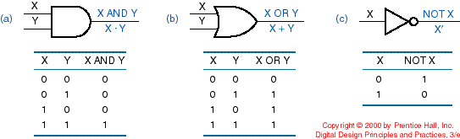
More Logic Gates
We can construct any combinational circuit with AND, OR, and NOT gates
Additional logic gates are used for practical reasons

Slide 30
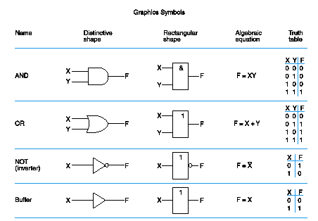
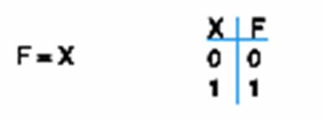
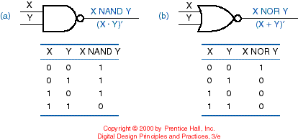
BUFFER, NAND and NOR

Slide 31
NAND Gate
Known as a “universal” gate because ANY digital circuit can be implemented with NAND gates alone.
To prove the above, it suffices to show that AND, OR, and NOT can be implemented using NAND gates only.

Slide 32
NAND Gate Emulation
F = (X•X)’
= X’+X’
= X’
X
F = X’
X
X
X
F X•Y
F = ((X•Y)’)’
= (X’+Y’)’
= X’’•Y’’
= X•Y
Y
Y
X
X
F = (X’•Y’)’
= X’’+Y’’
= X+Y
F = X+Y
Y
Y

Slide 33
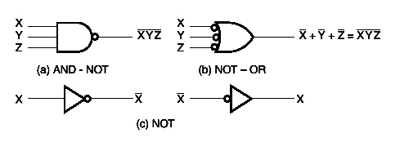
NAND Circuits
To easily derive a NAND implementation of a boolean function:
  Find a simplified SOP
  SOP is an AND-OR circuit
  Change AND-OR circuit to a NAND circuit
  Use the alternative symbols below

Slide 34
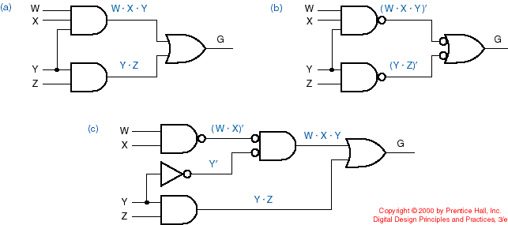
AND-OR (SOP) Emulation
Using NANDs
Two-level implementations
Original SOP
Implementation with NANDs

Slide 35
AND-OR (SOP) Emulation
Using NANDs (cont.)
Verify:
G = WXY + YZ
G = ( (WXY)’ • (YZ)’ )’
= (WXY)’’ + (YZ)’’ = WXY + YZ

Slide 36
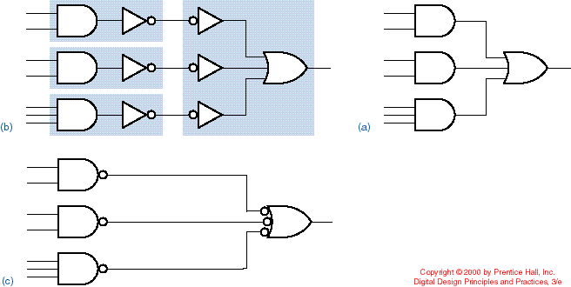
SOP with NAND
Original SOP
Double inversion and grouping
Replacement with NANDs
AND-NOT
NOT-OR

Slide 37
Two-Level NAND Gate Implementation - Example
F (X,Y,Z) = Σm(0,6)
Express F in SOP form:
F = X’Y’Z’ + XYZ’
Obtain the AND-OR implementation for F.
Add bubbles and inverters to transform AND-OR to NAND-NAND gates.

Slide 38
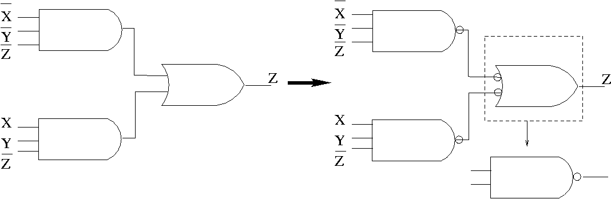
Example (cont.)
Two-level implementation with NANDs
F = X’Y’Z’ + XYZ’

Slide 39
Multilevel NAND Circuits
Starting from a multilevel circuit:
Convert all AND gates to NAND gates with AND-NOT graphic symbols.
Convert all OR gates to NAND gates with NOT-OR graphic symbols.
Check all the bubbles in the diagram. For every bubble that is not counteracted by another bubble along the same line, insert a NOT gate or complement the input literal from its original appearance.

Slide 40
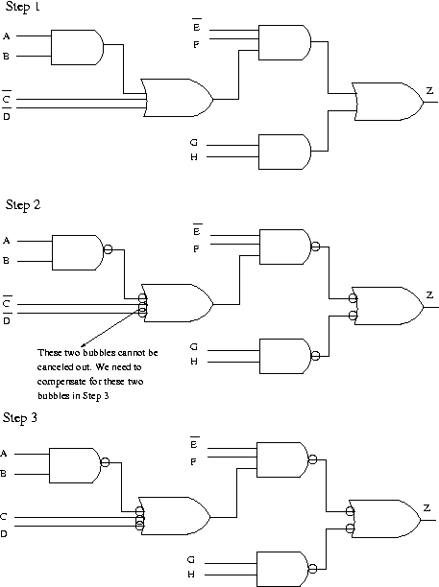
Example
Use NAND gates
and NOT gates to implement
Z=E’F(AB+C’+D’)+GH
AB
AB+C’+D’
E’F(AB+C’+D’)
E’F(AB+C’+D’)+GH

Slide 41
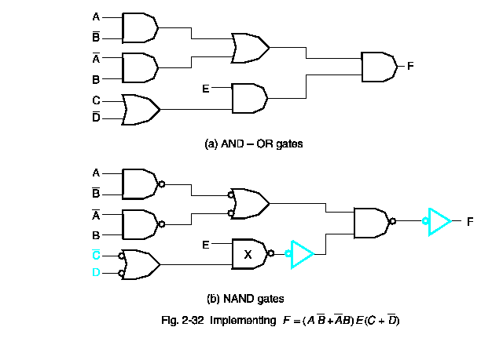
Yet Another Example!

Slide 42
NOR Gate
Also a “universal” gate because ANY digital circuit can be implemented with NOR gates alone.
This can be similarly proven as with the NAND gate.

Slide 43
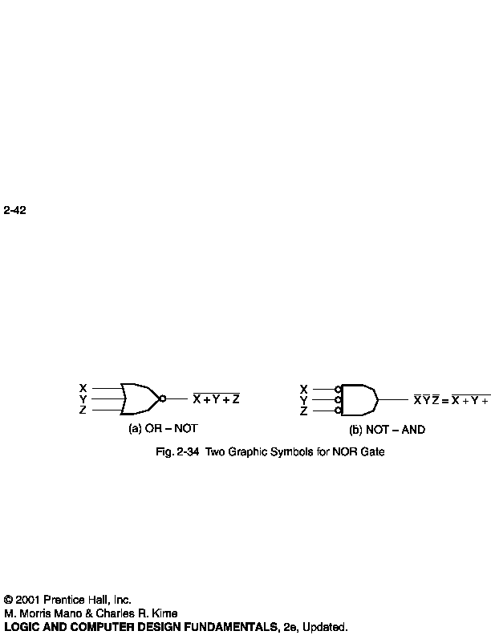
NOR Circuits
To easily derive a NOR implementation of a boolean function:
  Find a simplified POS
  POS is an OR-AND circuit
  Change OR-AND circuit to a NOR circuit
  Use the alternative symbols below

Slide 44
Two-Level NOR Gate Implementation - Example
F(X,Y,Z) = Σm(0,6)
Express F’ in SOP form:
  F’ = Σm(1,2,3,4,5,7)
  = X’Y’Z + X’YZ’ + X’YZ + XY’Z’ + XY’Z + XYZ
  F’ = XY’ + X’Y + Z
Take the complement of F’ to get F in the POS form: F = (F’)' = (X'+Y)(X+Y')Z'
Obtain the OR-AND implementation for F.
Add bubbles and inverters to transform OR-AND implementation to NOR-NOR implementation.

Slide 45
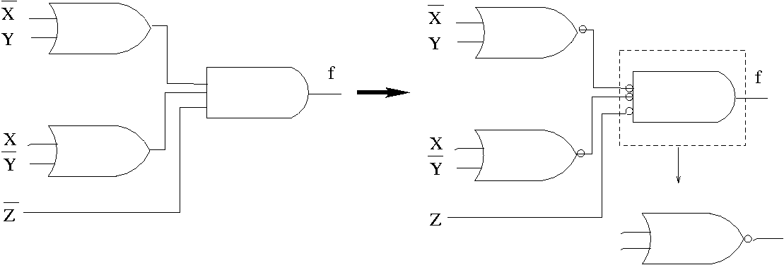
Example (cont.)
Two-level implementation with NORs
F = (F’)' = (X'+Y)(X+Y')Z'

Slide 46
XOR and XNOR
X | Y | F = X⊕Y
0 | 0 | 0
0 | 1 | 1
1 | 0 | 1
1 | 1 | 0
XOR: “not-equal” gate
X
F
Y
X | Y | F = X⊕Y
0 | 0 | 1
0 | 1 | 0
1 | 0 | 0
1 | 1 | 1
XNOR: “equal” gate
X
F
Y

Slide 47
Exclusive-OR (XOR) Function
XOR (also ⊕) : the “not-equal” function
XOR(X,Y) = X ⊕ Y = X’Y + XY’
Identities:
  X ⊕ 0 = X
  X ⊕ 1 = X’
  X ⊕ X = 0
  X ⊕ X’ = 1
Properties:
  X ⊕ Y = Y ⊕ X
  (X ⊕ Y) ⊕ W = X ⊕ ( Y ⊕ W)

Slide 48
XOR function implementation
XOR(a,b) = ab’ + a’b
Straightforward: 5 gates
  2 inverters, two 2-input ANDs, one 2-input OR
  2 inverters & 3 2-input NANDs
Nonstraightforward:
  4 NAND gates

Slide 49
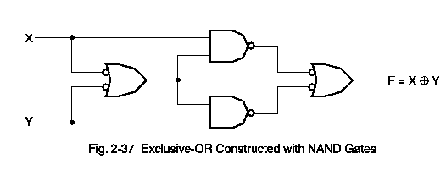
XOR circuit with 4 NANDs

